Slide 1

by
Data Analysis

Slide 2
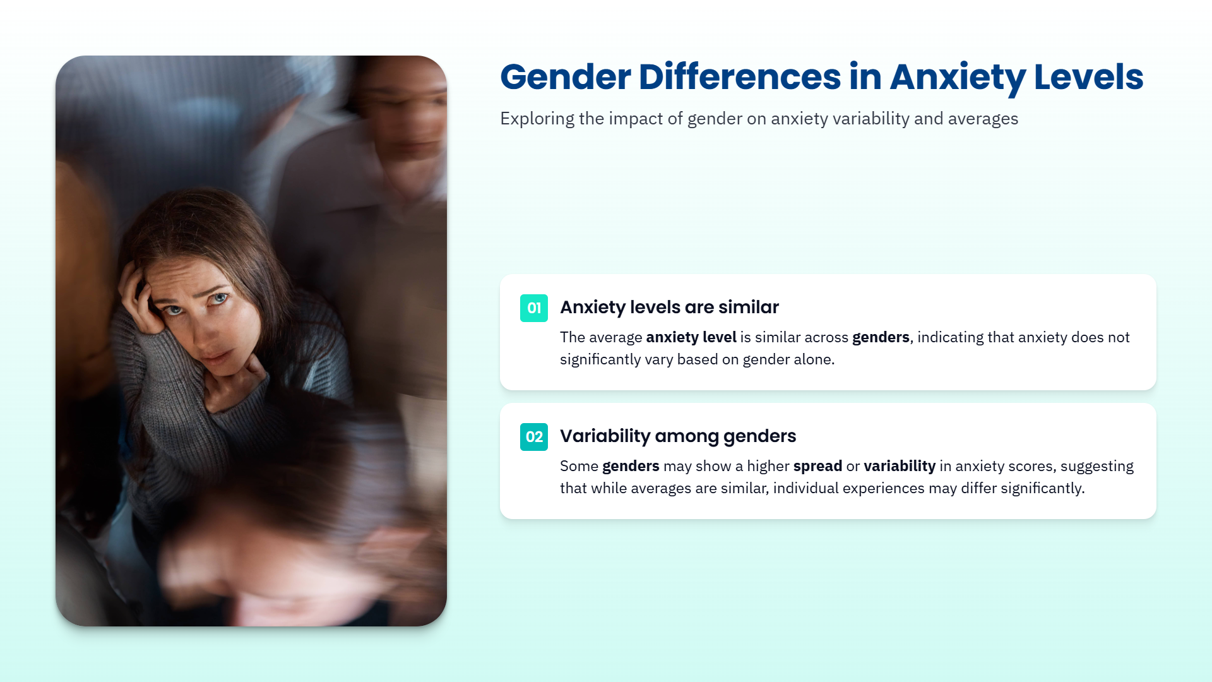

Slide 3



Slide 4

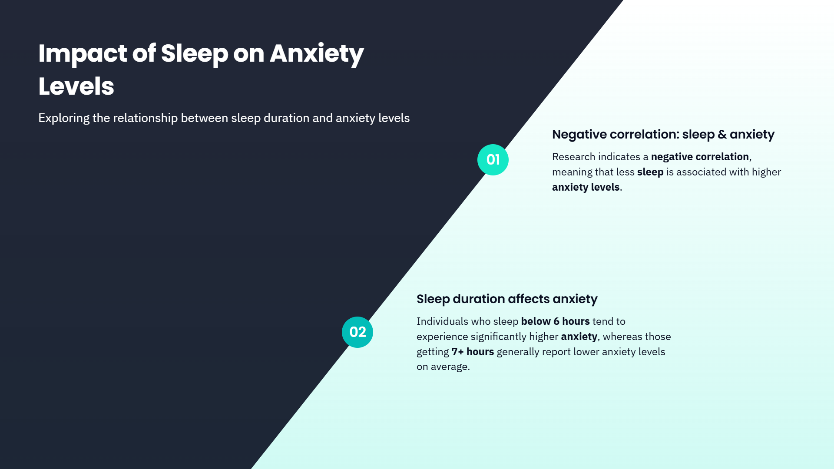

Slide 5
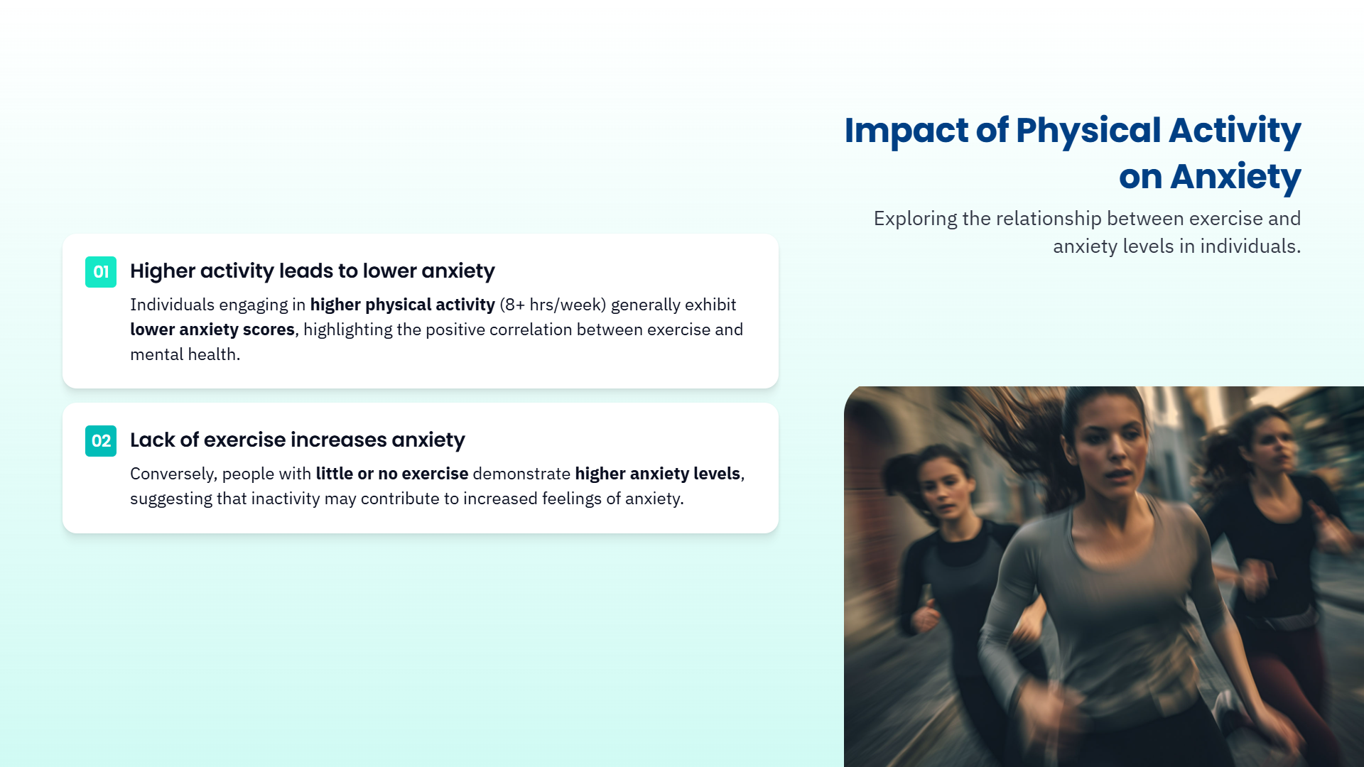

Slide 6


Slide 7
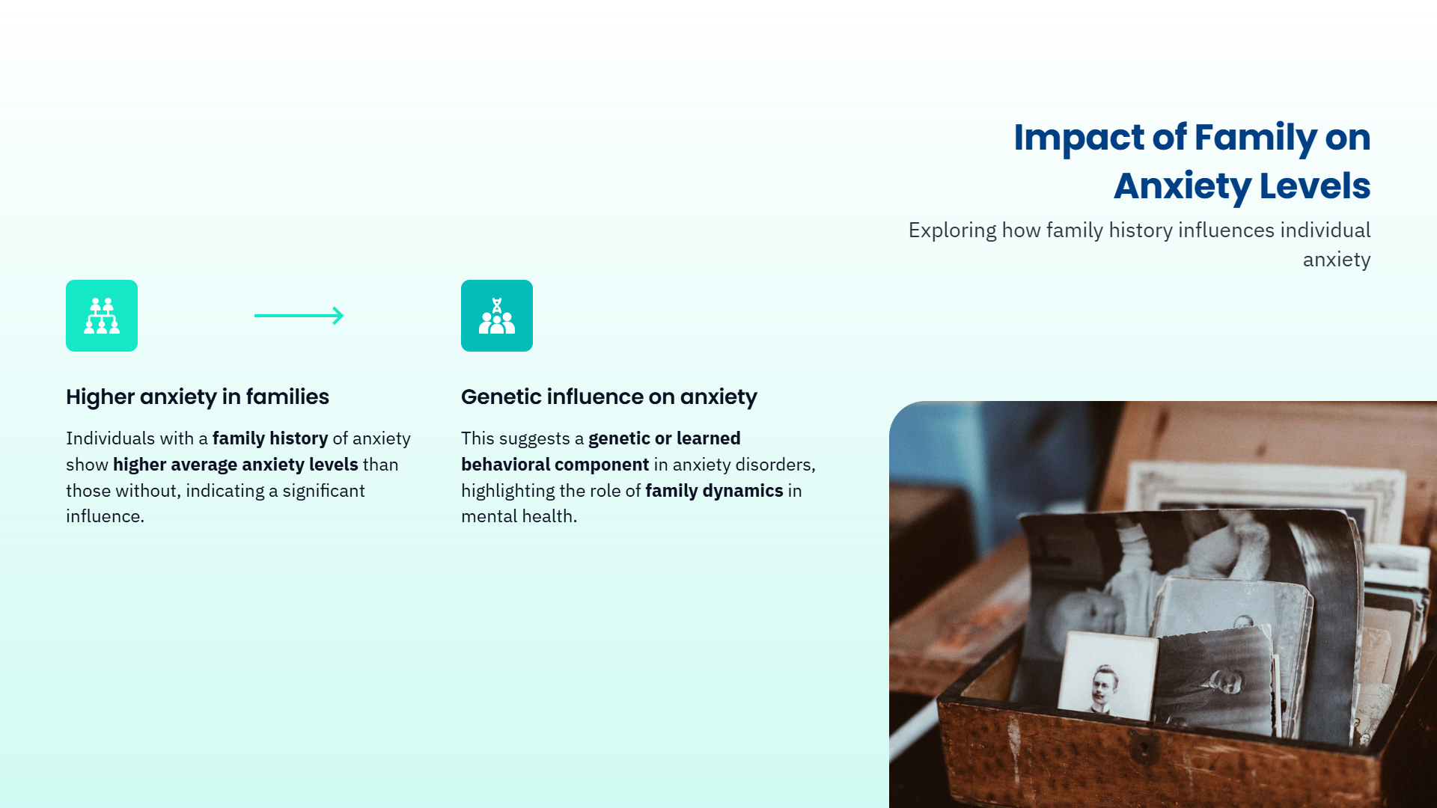

Slide 8
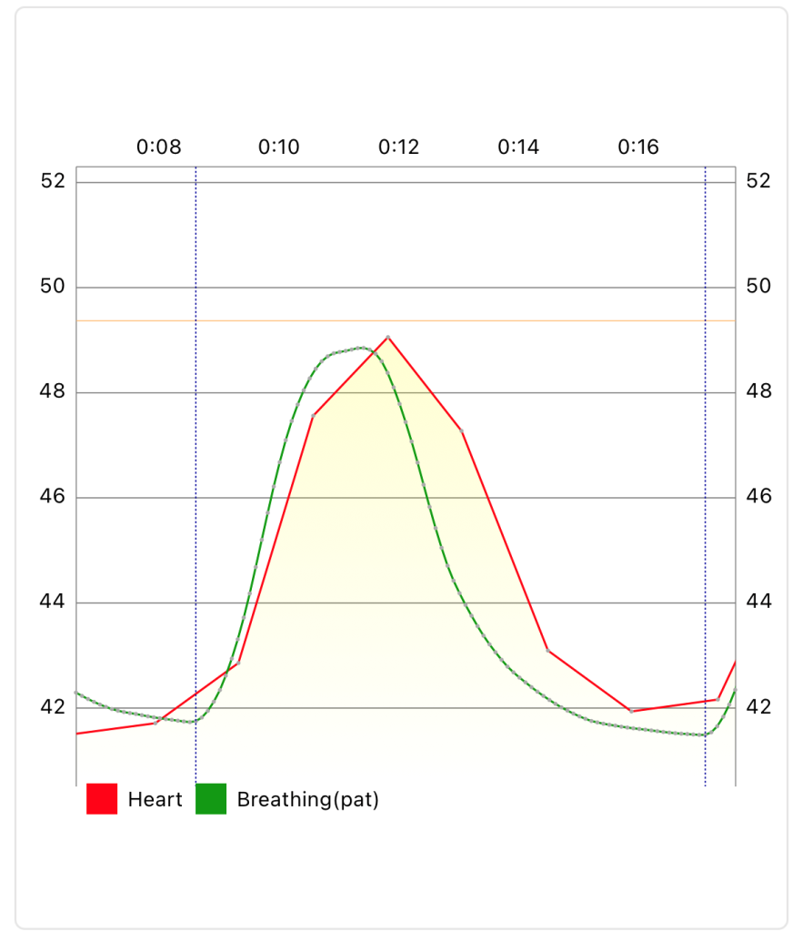
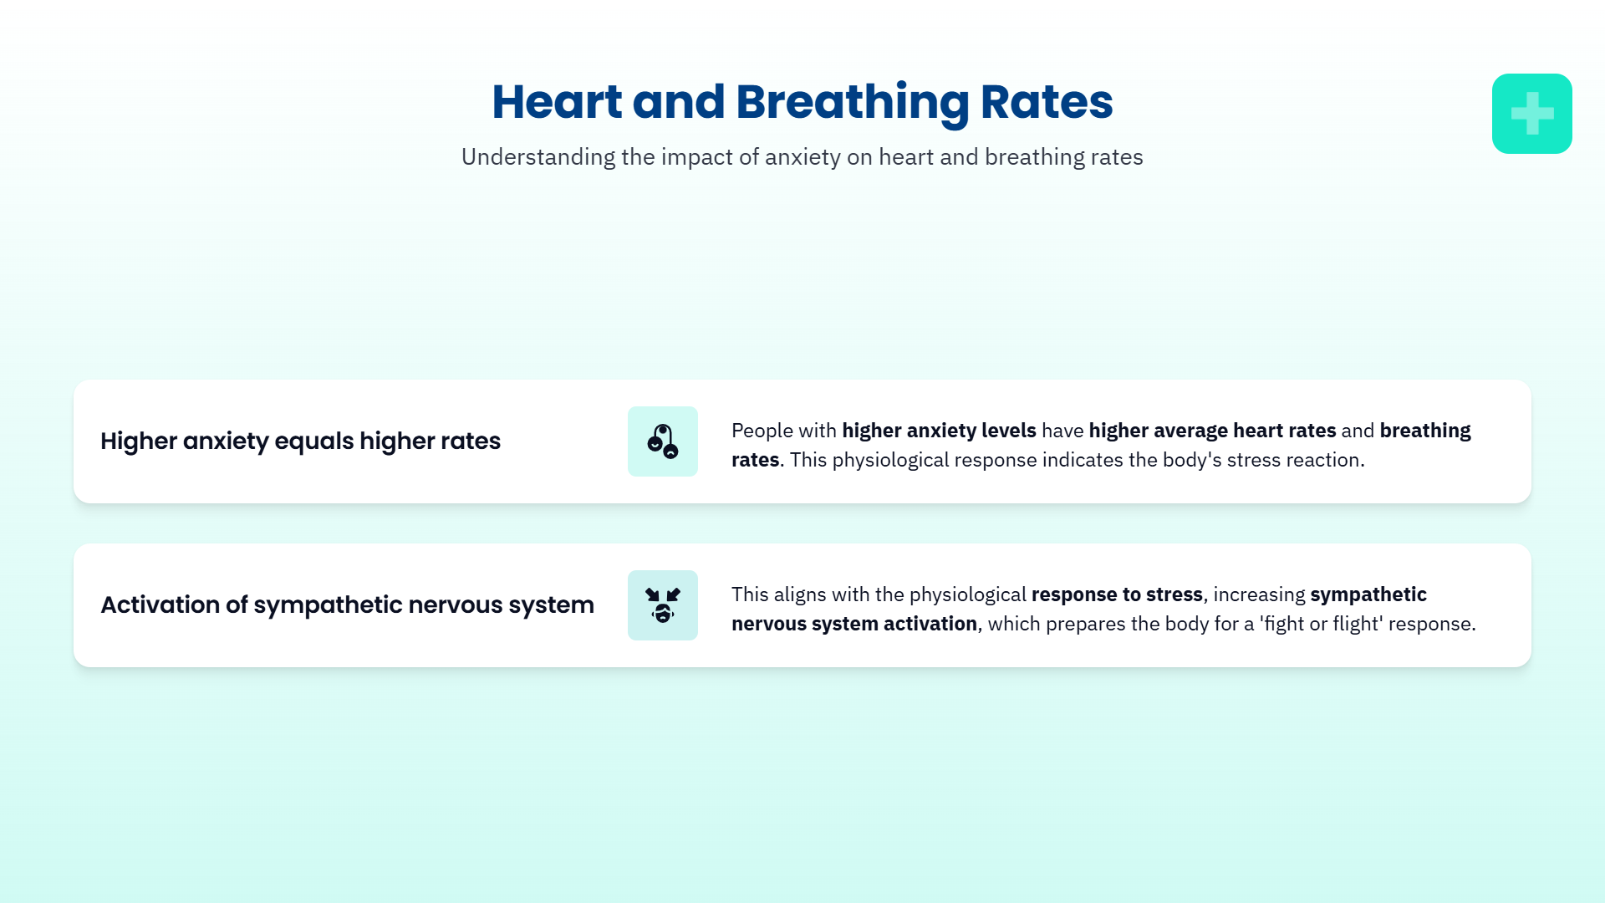

Slide 9
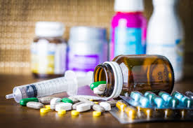


Slide 10


Slide 11


Slide 12


Slide 13




Slide 14

Yashraj Singh
📧[yashrajsingh2288@gmail.com]
🔗Github | [ https://github.com/Yashrajyr1 ]
🔗LinkedIn | [ https://www.linkedin.com/in/yashrajsingh-/ ]

